Slide 1
Digital Portfolio
STUDENT NAME: SHEEBA S
REGISTER NO AND NMID: 222404650/82A6FE51C9A97B19C4E4BF7D53F26F01
DEPARTMENT: Computer science with artificial intelligence
COLLEGE: Agurchand manmull jain college/madras university

Slide 2
PROJECT TITLE
Student Portfolio Website

Slide 3


AGENDA
Problem Statement
Project Overview
End Users
Tools and Technologies
Portfolio design and Layout
Features and Functionality
Results and Screenshots
Conclusion
Github Link
3/21/2024 Annual Review

Slide 4

PROBLEM STATEMENT
Students often struggle to present their academic achievements, skills, and certifications in a professional and interactive format. Traditional resumes are static and lack personalization. There is a need for a dynamic, web-based portfolio that allows students to showcase their profiles in a visually appealing and accessible way.

Slide 5

PROJECT OVERVIEW
The Student Portfolio Website is a responsive, single-page web application built using HTML, CSS, and JavaScript. It provides students with a clean and interactive dashboard to display their certificates, resume, and contact information. The site uses JavaScript to switch between sections without reloading the page, offering a smooth user experience.

Slide 6

WHO ARE THE END USERS?
College students
Job seekers
Academic institutions
Recruiters and hiring managers

Slide 7

TOOLS AND TECHNIQUES
1.Languages Used
HTML → Structured the layout and content of the dashboard
CSS → Styled the interface with responsive design and hover effects
JavaScript → Enabled interactive section switching and dynamic content display
2. Development Tools
VS Code → Code editor used for building the project
Git & GitHub → Version control and code hosting platform

Slide 8
POTFOLIO DESIGN AND LAYOUT
Navigation Bar → Four sections: Home, Certificate, Resume, Contact
Dynamic Sections → Content displayed interactively linksusing JavaScript
User Interface → Clean and modern design with consistent styling
Responsive Layout → Intuitive user flow across devices
Color Scheme → Blue primary theme with green highlight for active
8

Slide 9
FEATURES AND FUNCTIONALITY
Interactive Navigation → Active state highlighting for selected section
Certificates Section → Lists completed courses (HTML5, CSS3, JavaScript)
Resume Section → Displays personal details, education, and skills
Contact Section → Shows email, phone number, and location
Dynamic Interaction → JavaScript toggles section visibility without page reload

Slide 10
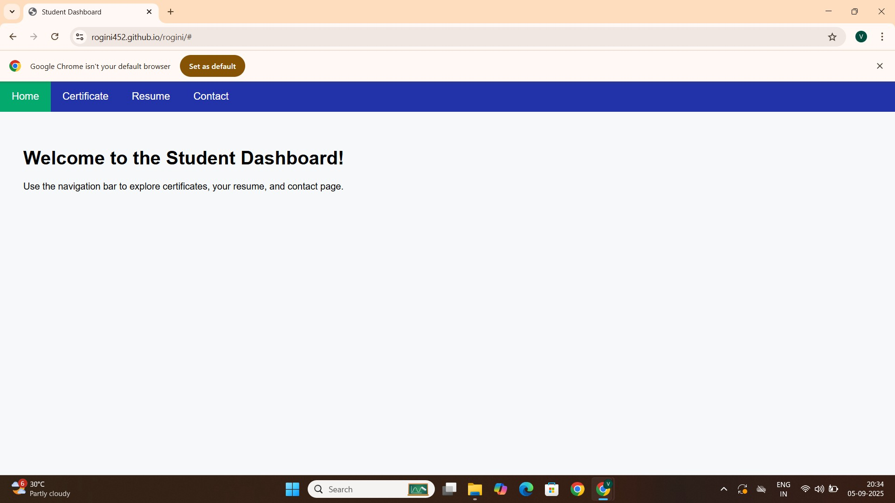

RESULTS AND SCREENSHOTS
3/21/2024 Annual Review
10

Slide 11
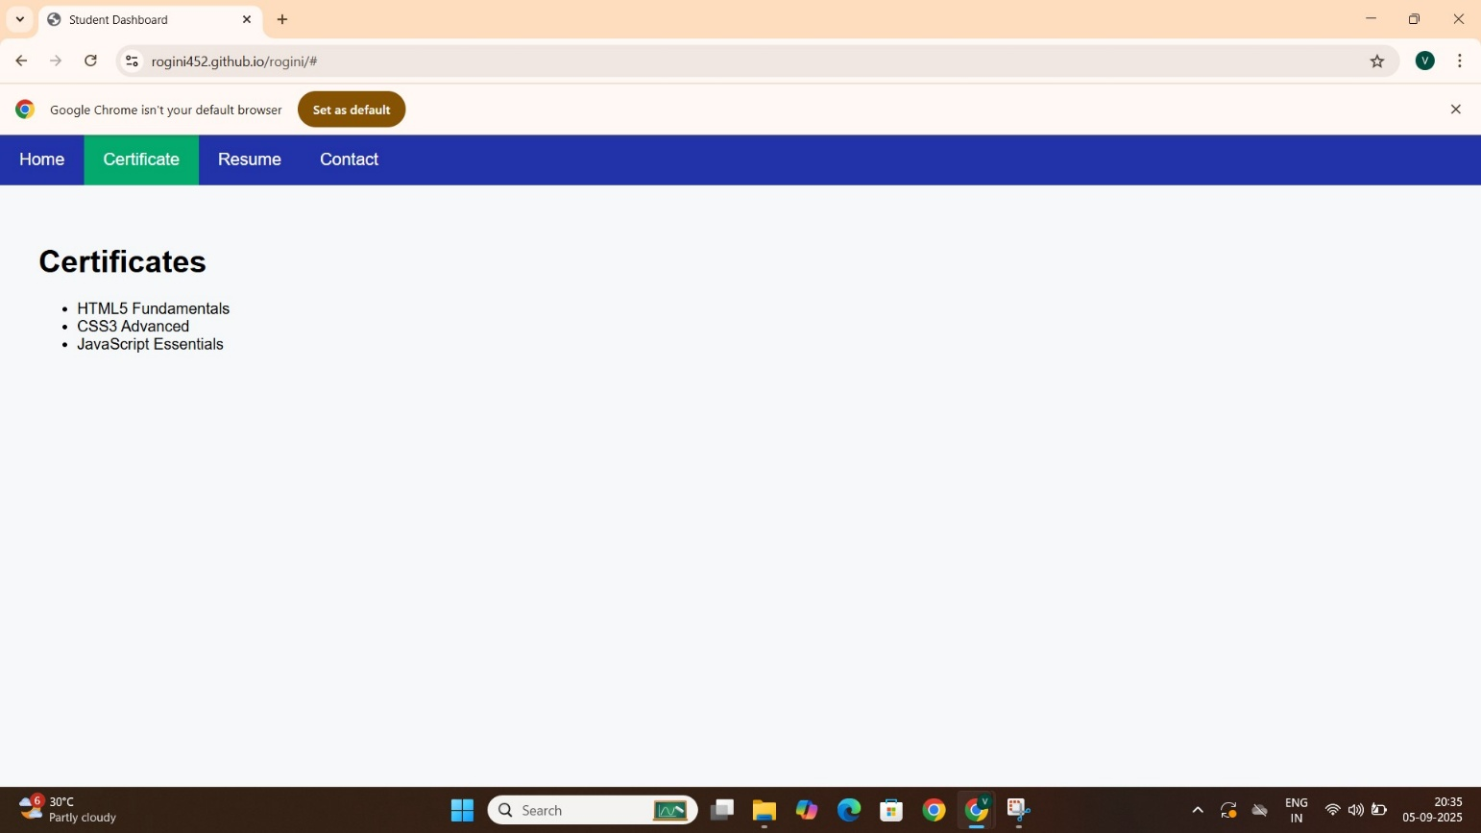
RESULTS AND SCREENSHOTS
3/21/2024 Annual Review
11

Slide 12
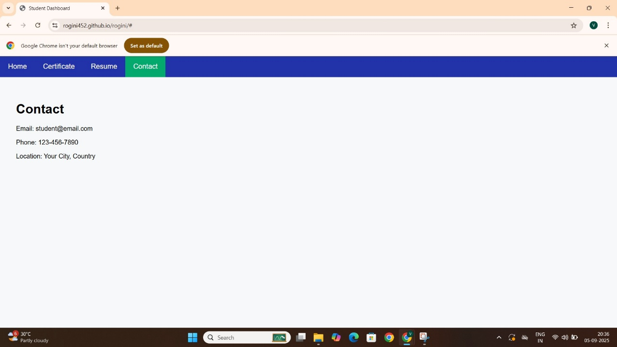
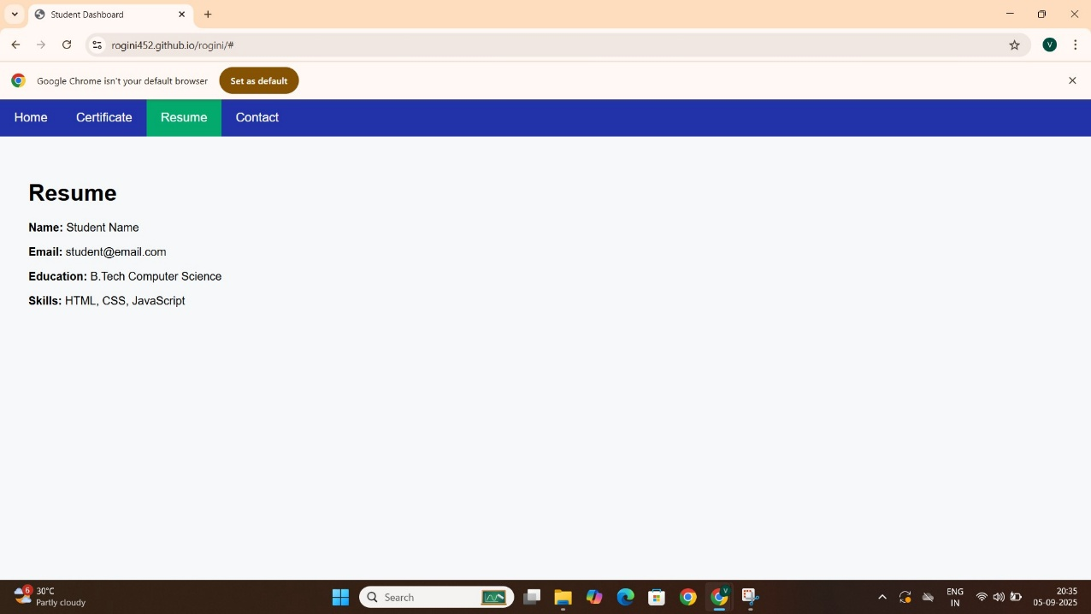
RESULTS AND SCREENSHOTS

Slide 13
CONCLUSION
The Student Portfolio Website offers a modern solution for students to present their academic and professional profiles online. It enhances visibility and accessibility, making it easier for recruiters and institutions to evaluate candidates. Future improvements may include downloadable resume integration, profile analytics, and backend support for data storage.
13

